Slide 1

Advanced Prompt Engineering
Techniques, Dev Process and Papers
J. Yarkoni - CEO Shujin AI consulting Ex-Google AI/ML Specialist
Notes:
Name
Background
Previously spent 6 years at google
Recently Shujin
Where we have done several prompt engineering projects
Suggest a topic
Resources - bottom of pages.
Email last slide

Slide 2
What you will learn
Theory
Practical
Token, LLM types, parametric, RAG
Prompt structure, Techniques, tips, process for crafting, Relevant papers, how to start
Notes:
Also, we will focus on on text
Roughly speaking - divide

Slide 3
Domain expertise + Prompt knowledge
No Silver Bullet
Notes:
We will focus on how to prompt engineer
We won’t cover domain knowledge but instead demonstrate on relatable scenario like “guards” and “cold emails”
Also there’s no 15 magic prompts. It takes time and effort.
If you don’t believe me try solving the “guards” problem on your own.

Slide 4
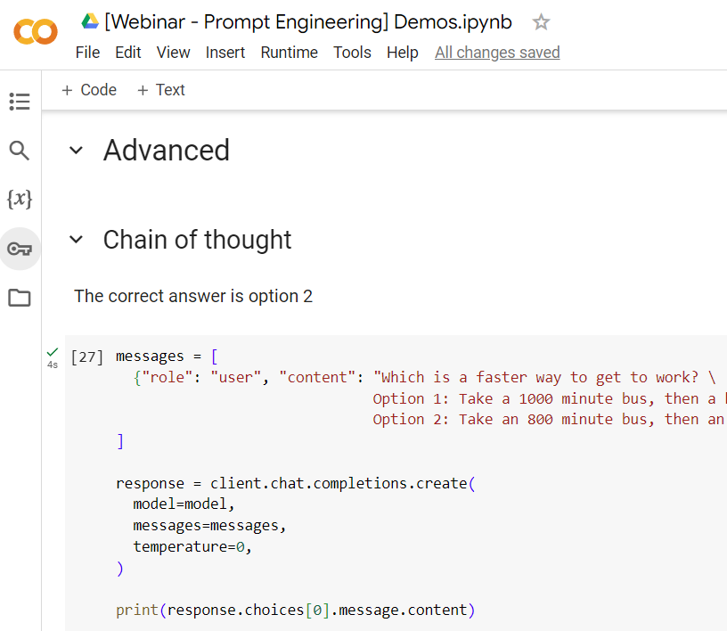
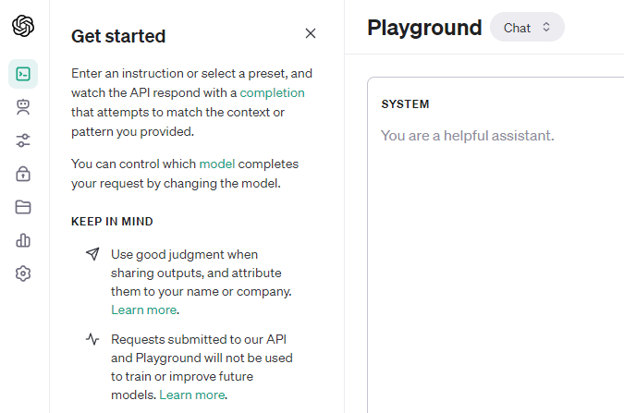
Environment
Open AI playground
/
ChatGPT
Colab
Notes:
For the sake of time I will be using a notebook environment
You can test it out either on chatGPT or better, on the OpenAI playground.
If you want the collab, send me a mail. My mail will be on the last slide,

Slide 5
Agenda
01
03
02
04
Demos
Prompt eng. process
X4
Hands on example
Techniques
Papers & Resources
Basic, advanced, concepts
What to read,
Where to learn
Notes:
There is no 15 magical prompt
There is no prompt marketplace or hub
We will start from a demo showcasing everything you will learn today.
We will break down every concept / trick with a basic example.
Basic will get you pretty far on most problems but nowhere on few problems.
We will be using weaker models in order to demonstrate the pitfalls.

Slide 6
Prompt engineering is the skill of crafting effective prompts by identifying the right contextual cues to integrate.
A well-designed prompt acts analogous to a program, steering the model to execute the intended task through its written response.
Prompt
https://papers.ssrn.com/sol3/papers.cfm?abstract_id=4573321
Notes:
Guide the model
Think of a toddler
Spark their memory
Illusion of ease
Guards demo

Slide 7


Let’s learn
Great
Bad
Notes:
For the sake of time I will be using a notebook environment
You can test it out either on chatGPT or better, on the OpenAI playground.
If you want the collab, send me a mail. My mail will be on the last slide,

Slide 8
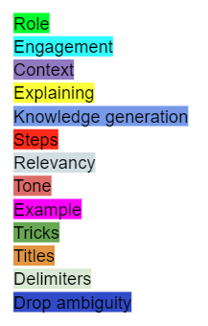
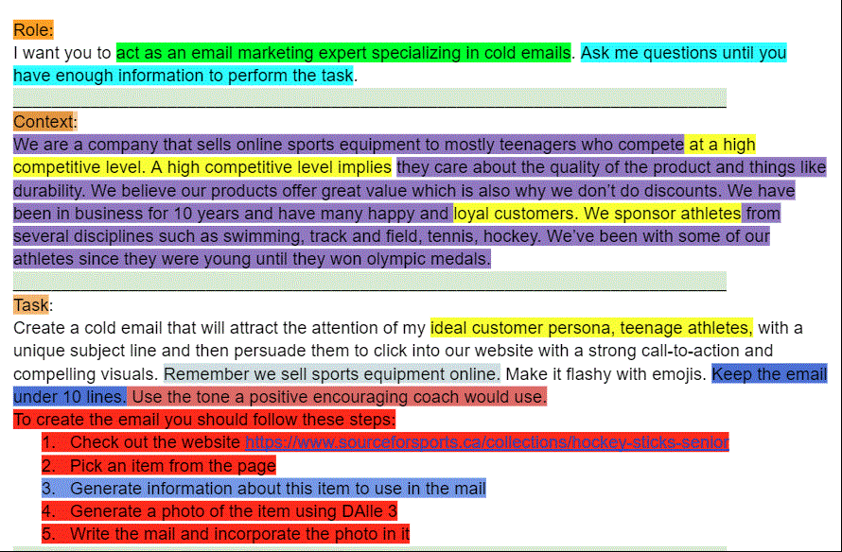
Notes:
Color coded
We’ll be reviewing this demo at the end
After I’ve taught you the basics and advanced concepts.

Slide 9
01
Basics - Structure of a Prompt
Task | Instructing the model what you want it to do
Context | Add information that will help the model perform its task
Role | capture more and better semantic relationships
Format | Desired output to look
Tone | Style of writing
Examples | Additional context in output format
Constraints | Remind the model of the boundaries
Notes:
Quickly
Summarize
Analyze
Blog posts
Essays
Cold emails
Again - mental model
Guide
Spark
The more context we give it the better it will perform.
Not only for styling: - Mathematician
Trigger a more analytical approach
Philopsospher
Bullet points, Essays, Poems
Formal, legal, steve jobs
If you’ve been following news with Google gemini you know that examples matter

Slide 10

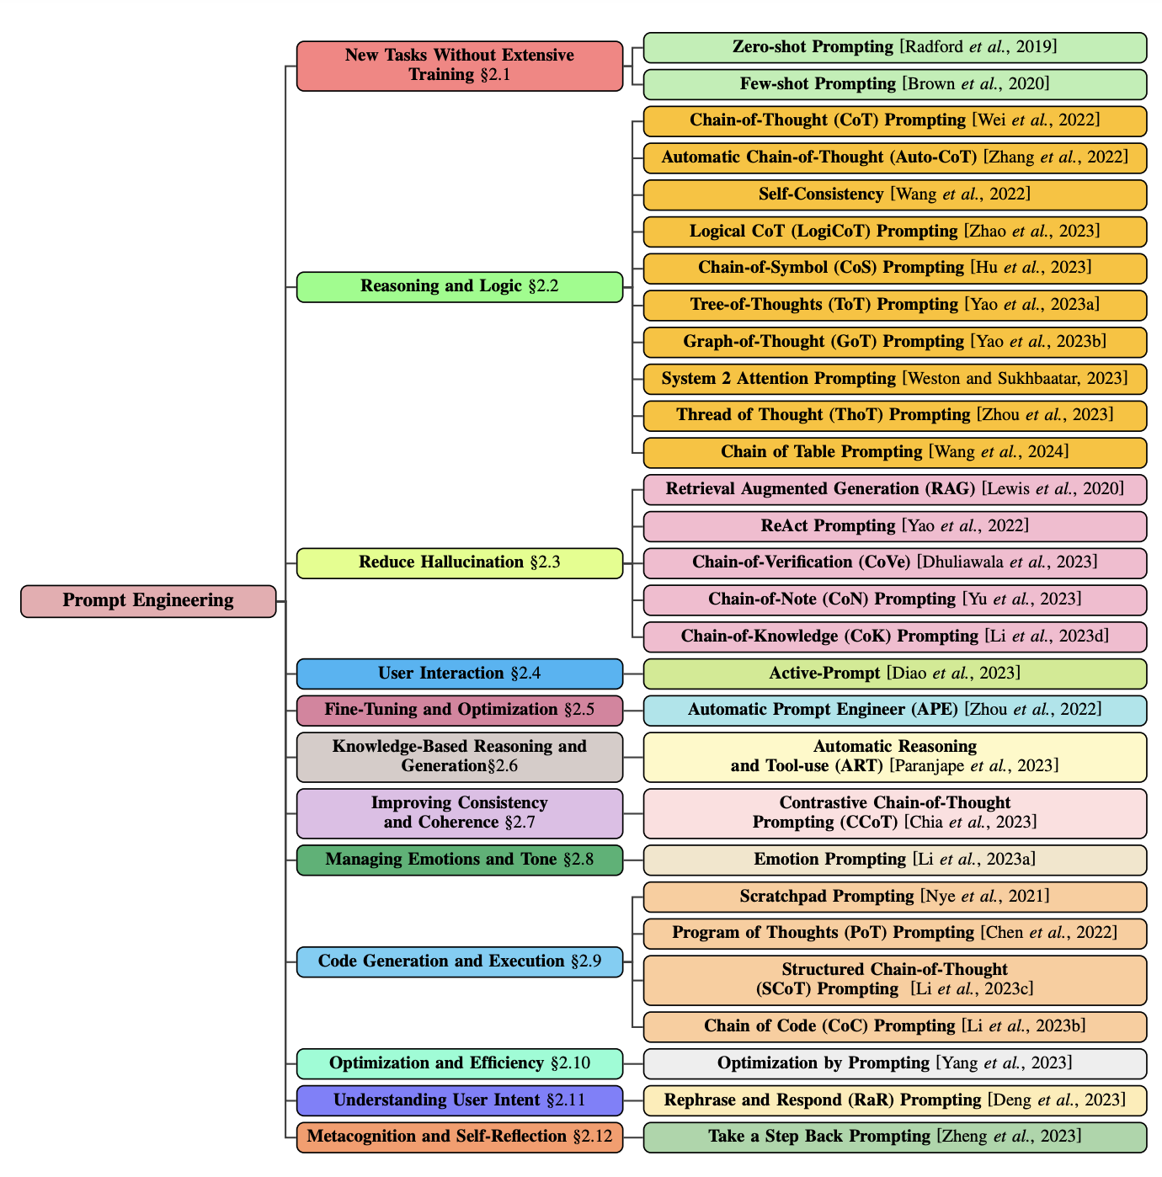
02
Advanced
Potential 34%+ gain on benchmarks
https://arxiv.org/pdf/2402.07927.pdf
Notes:
Performance increased by a lot. This matters.
You need to be familiar.
Even if you’re not using them per se “They give you a sense”
This is an art not only a science.
If you’re familiar with what works and what doesn’t work you will be able to better guide the model.
Remember it’s on you to guide the model.
“CoT only yields performance gains when used with models of ∼100B parameters". Smaller models wrote illogical chains of thought, which led to worse accuracy than standard prompting”
I won’t go over all of them

Slide 11
02
Advanced
Chain of thought
Skeleton of thought
Self consistency
Generated knowledge
Least to most
Chain of verification
Step back prompting
Rephrase and respond
Emotion prompt
Directional stimuli
Recursive Criticism and Improvement
Reverse prompting
Potential 34%+ gain on benchmarks
https://arxiv.org/pdf/2201.11903.pdf
https://arxiv.org/abs/2203.11171.pdf https://arxiv.org/pdf/2110.08387.pdf https://arxiv.org/pdf/2205.10625.pdf https://arxiv.org/pdf/2309.11495.pdf https://arxiv.org/pdf/2310.06117.pdf https://arxiv.org/pdf/2311.04205.pdf https://arxiv.org/pdf/2307.11760.pdf https://arxiv.org/pdf/2311.11829.pdf https://arxiv.org/pdf/2309.03409.pdf
Notes:
Performance increased by a lot. This matters.
You need to be familiar.
Even if you’re not using them per se “They give you a sense”
This is an art not only a science.
If you’re familiar with what works and what doesn’t work you will be able to better guide the model.
Remember it’s on you to guide the model.
“CoT only yields performance gains when used with models of ∼100B parameters". Smaller models wrote illogical chains of thought, which led to worse accuracy than standard prompting”
I won’t go over all of them

Slide 12
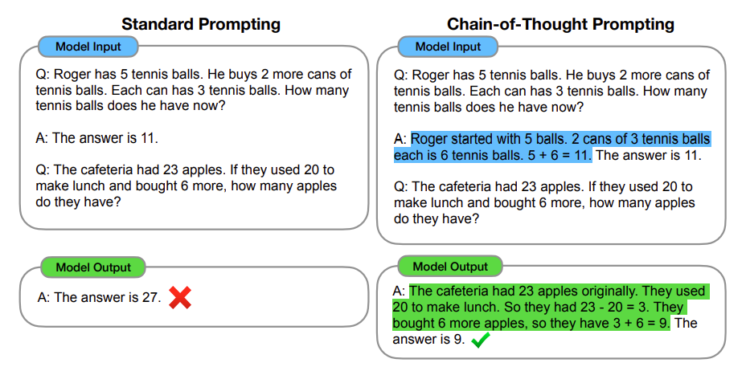
Chain of Thought
Two options:
Exemplars
“Let’s think this step By step”
Notes:
Doesn’t work on small 7B models

Slide 13
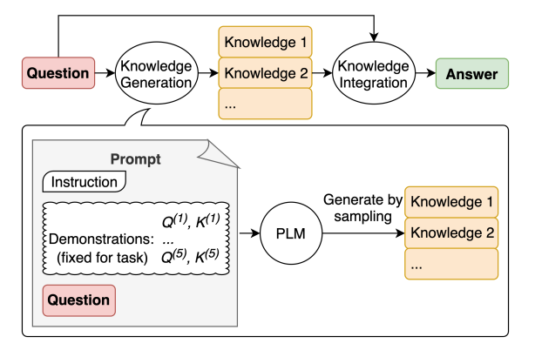
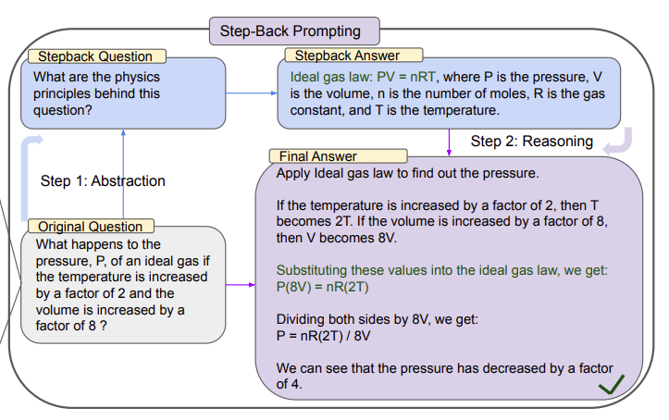
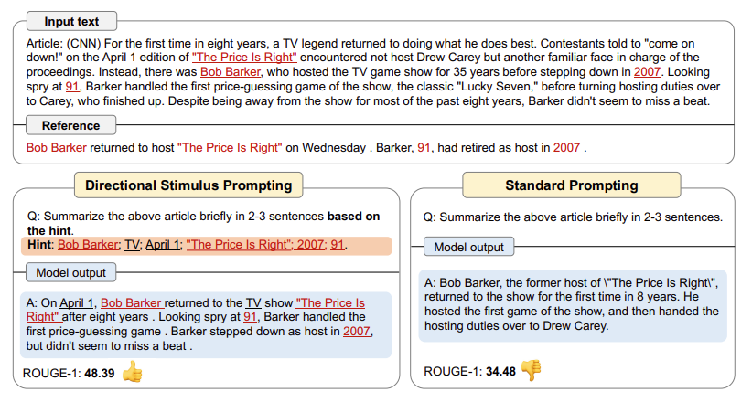
Post Query Model Enhancement
Knowledge
Hint
Concepts
Notes:
Additional context to the query

Slide 14
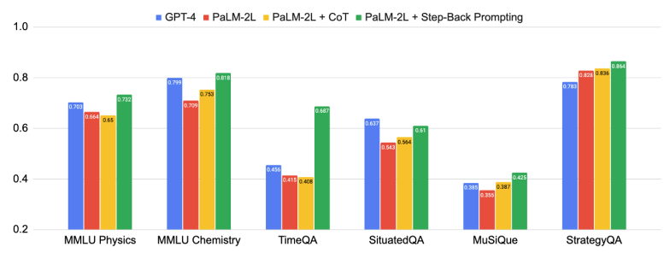
Step Back Prompting
Improves on CoT
Notes:
Improves on CoT

Slide 15
Directional Stimuli
Pre generate a hint.
Use the hint with the model.
Notes:
: The self-consistency method contains three steps: (1) prompt a language model using
chain-of-thought (CoT) prompting; (2) replace the “greedy decode” in CoT prompting by sampling
from the language model’s decoder to generate a diverse set of reasoning paths; and (3) marginalize
out the reasoning paths and aggregate by choosing the most consistent answer in the final answer set.

Slide 16
Step Back Prompting
Abstract and then reason
Notes:
: The self-consistency method contains three steps: (1) prompt a language model using
chain-of-thought (CoT) prompting; (2) replace the “greedy decode” in CoT prompting by sampling
from the language model’s decoder to generate a diverse set of reasoning paths; and (3) marginalize
out the reasoning paths and aggregate by choosing the most consistent answer in the final answer set.

Slide 17
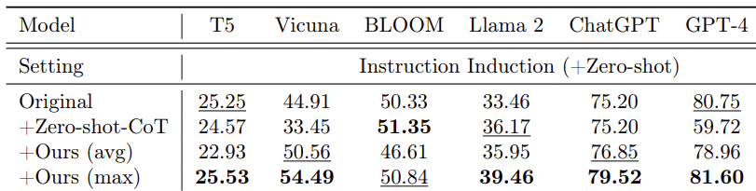
Emotional Stimuli
“My job depends on it”
“Take pride in your work and give it your best”
Notes:
Self monitoring
Social Cognitive cognitive

Slide 18
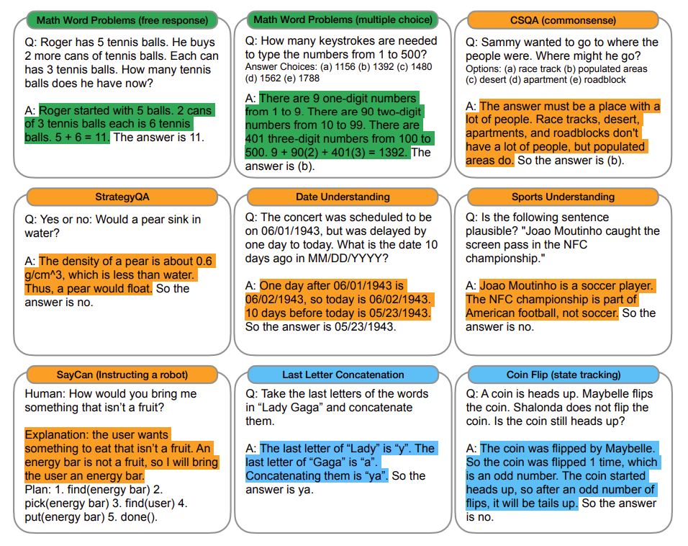
Chain of Thought
Two options
Exemplars
“Let’s think this step By step”
Notes:
Did not work. Had to be more specific.
Specific is important. Similar to how you talk to a human.
Starting to look more appealing “as one of the most decorated hockey players.
This is so important that most papers actually specify how many shots they used.
Highly debated on the Gemini release.

Slide 19
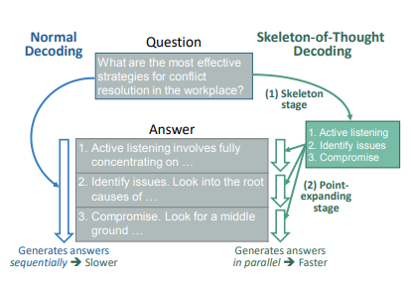
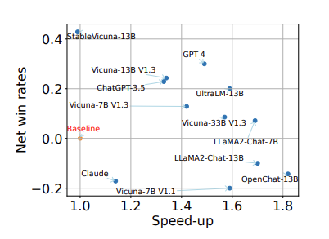
Skeleton of thought
Reduces latency by
parallelizing the work
Notes:
It does not reduce the processing power or cost since you are still producing the same number of tokens.

Slide 20
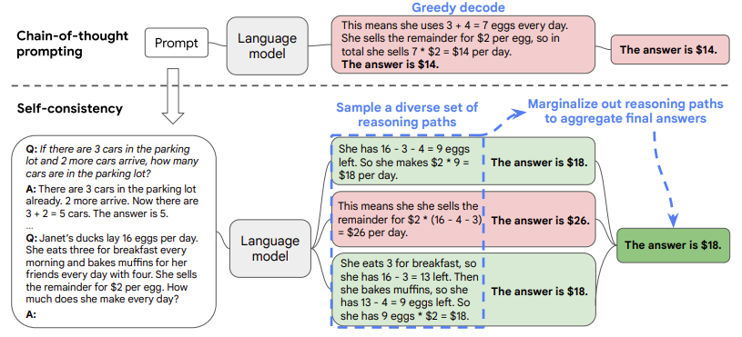
Self Consistency
Explores different paths of reasoning and selects one.
GSM8K (+17.9%), SVAMP (+11.0%), AQuA (+12.2%),
StrategyQA (+6.4%) ARC-challenge (+3.9%)
Notes:
: The self-consistency method contains three steps: (1) prompt a language model using
chain-of-thought (CoT) prompting; (2) replace the “greedy decode” in CoT prompting by sampling
from the language model’s decoder to generate a diverse set of reasoning paths; and (3) marginalize
out the reasoning paths and aggregate by choosing the most consistent answer in the final answer set.

Slide 21
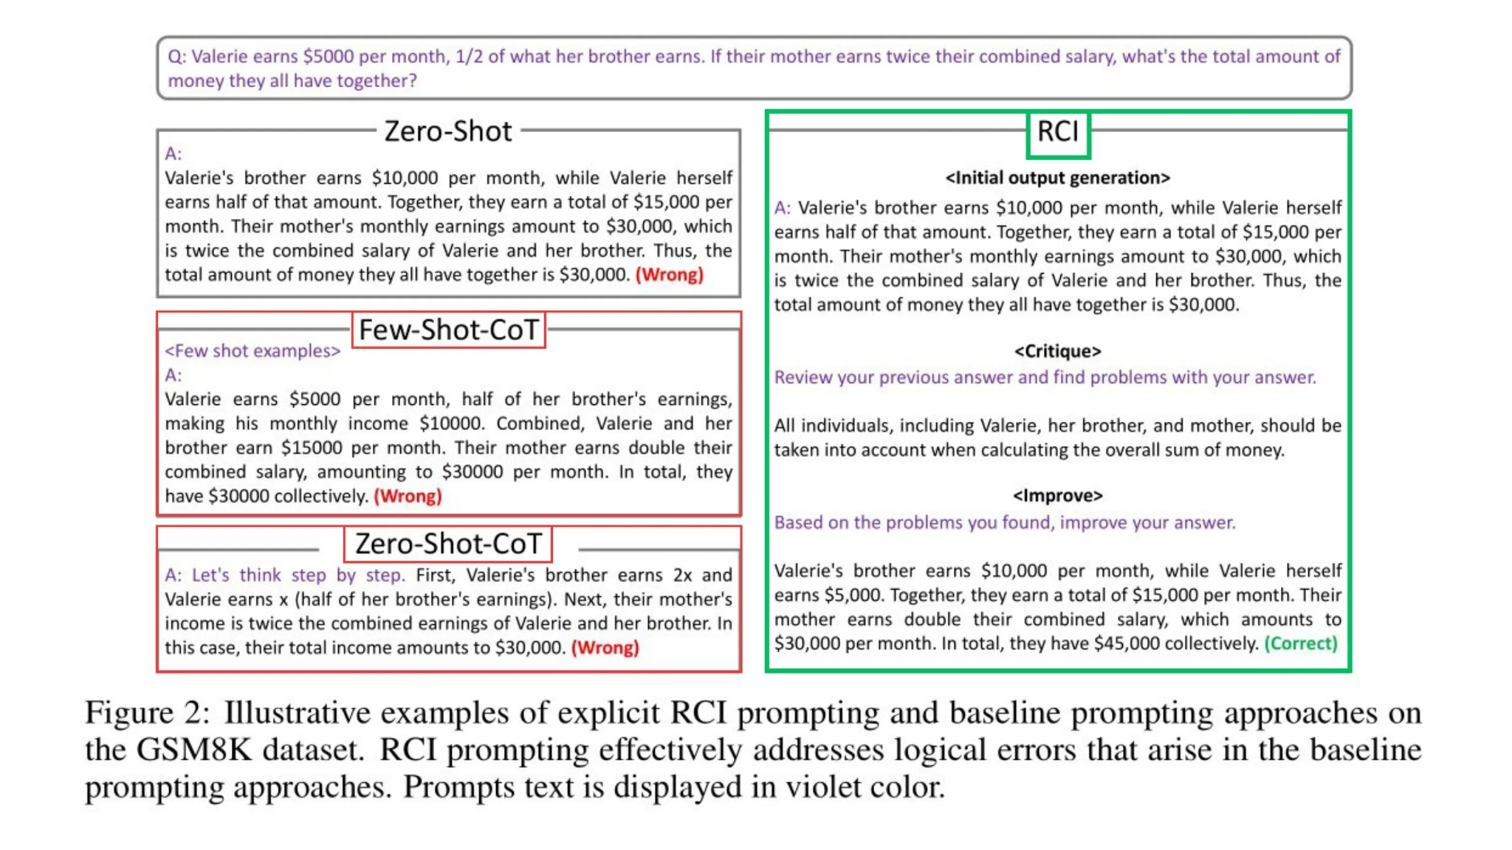
Recursive Criticism and Improvement
Ask ChatGPT to critique your prompt
Then ask it to fix the prompt
Notes:
: The self-consistency method contains three steps: (1) prompt a language model using
chain-of-thought (CoT) prompting; (2) replace the “greedy decode” in CoT prompting by sampling
from the language model’s decoder to generate a diverse set of reasoning paths; and (3) marginalize
out the reasoning paths and aggregate by choosing the most consistent answer in the final answer set.

Slide 22
Reverse Prompt Eng.
Start with the end result
Ask GPT to give you a prompt that can generate it.
Notes:
: The self-consistency method contains three steps: (1) prompt a language model using
chain-of-thought (CoT) prompting; (2) replace the “greedy decode” in CoT prompting by sampling
from the language model’s decoder to generate a diverse set of reasoning paths; and (3) marginalize
out the reasoning paths and aggregate by choosing the most consistent answer in the final answer set.

Slide 23
Prompt Revision
Ask GPT to make your prompt better
Great method for begginers
Notes:
This tech really helps when you’re a begginer

Slide 24
Demo
Colab advanced - https://colab.research.google.com/drive/1Xz8hUTztWJgqLOzCPT4D0UznPBc_DPo_?usp=sharing

Slide 25
Paper name | Date | Institute author | Paper
Self consistency | March 2022 | Google | https://arxiv.org/abs/2203.11171
Generated knowledge | Sept 2022 | Washington university | https://arxiv.org/pdf/2110.08387.pdf
Chain of thought | Jan 2023 | Google | https://arxiv.org/pdf/2201.11903.pdf
Least to most | April 2023 | Google | https://arxiv.org/pdf/2205.10625.pdf
Chain of verification | Sept 2023 | Meta | https://arxiv.org/pdf/2309.11495.pdf
Skeleton of thought | Oct 2023 | Microsoft | https://arxiv.org/pdf/2307.15337.pdf
Step back prompting | Oct 2023 | Google | https://arxiv.org/pdf/2310.06117.pdf
Rephrase and Respond | Nov 2023 | UCLA University | https://arxiv.org/pdf/2311.04205.pdf
Emotion Stimuli | Nov 2023 | Microsoft | https://arxiv.org/pdf/2307.11760.pdf
System 2 attention | Nov 23 | Meta | https://arxiv.org/pdf/2311.11829.pdf
OPRO | Dec 2023 | Google | https://arxiv.org/pdf/2309.03409.pdf
Notes:
Green google
Red MSFT
Blue Meta

Slide 26
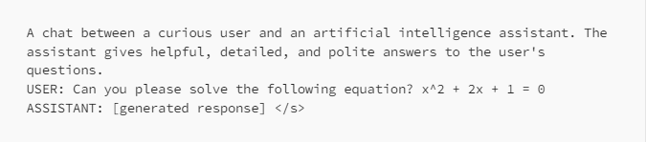

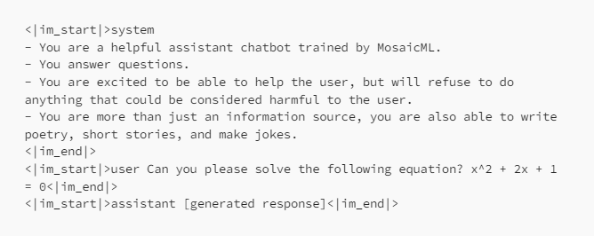

Model Variance
Each model was:
Method
Dataset
Syntax
Purpose
Capabilities
Etc.
Therefore models behaves differently
https://huggingface.co/spaces/HuggingFaceH4/open_llm_leaderboard
https://medium.com/@marcotcr/exploring-chatgpt-vs-open-source-models-on-slightly-harder-tasks-aa0395c31610
Notes:
Did not work. Had to be more specific.
Specific is important. Similar to how you talk to a human.
Starting to look more appealing “as one of the most decorated hockey players.

Slide 27
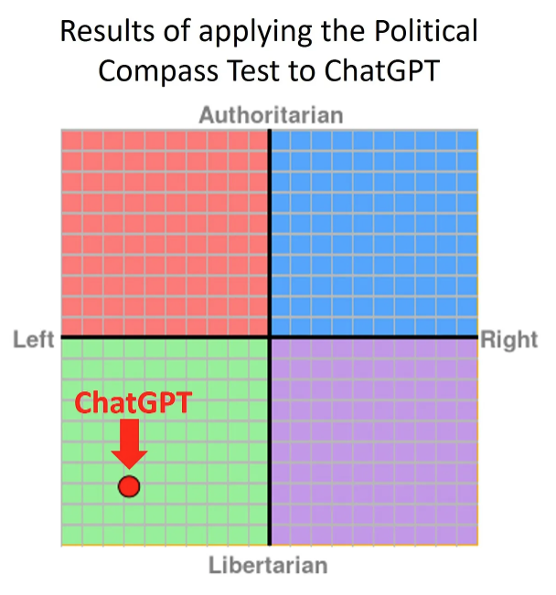
Model Variance
Each model was:
Method
Dataset
Syntax
Purpose
Capabilities
Etc.
Therefore models behaves differently
https://davidrozado.substack.com/p/the-political-orientation-of-the
Notes:
Did not work. Had to be more specific.
Specific is important. Similar to how you talk to a human.
Starting to look more appealing “as one of the most decorated hockey players.

Slide 28

Model Variance
Each model was:
Method
Dataset
Syntax
Purpose
Capabilities
Etc.
Therefore models behaves differently
https://huggingface.co/spaces/HuggingFaceH4/open_llm_leaderboard
https://medium.com/@marcotcr/exploring-chatgpt-vs-open-source-models-on-slightly-harder-tasks-aa0395c31610
Notes:
Did not work. Had to be more specific.
Specific is important. Similar to how you talk to a human.
Starting to look more appealing “as one of the most decorated hockey players.

Slide 29
Demo
Colab “guards”- https://colab.research.google.com/drive/1Xz8hUTztWJgqLOzCPT4D0UznPBc_DPo_?usp=sharing

Slide 30
03
Concepts
Clear instructions
Provide reference text
Split complex tasks into smaller ones
Use external tools
Be specific
Remove fluff
Explain
Prioritize
Negative prompts are less effective than positive prompts
Recency bias (long)
Negating bias
Be aware of hallucinations
How to get more examples: use GPT4 (a stronger model)
Chatiness vs. succinct
How to engage
Continue / elaborate more
Separators for clarity
https://platform.openai.com/docs/guides/prompt-engineering
Notes:
“CoT only yields performance gains when used with models of ∼100B parameters". Smaller models wrote illogical chains of thought, which led to worse accuracy than standard prompting”
“CoT only yields performance gains when used with models of ∼100B parameters". Smaller models wrote illogical chains of thought, which led to worse accuracy than standard prompting”
“There are several different possible ones but step by step works the best”

Slide 31
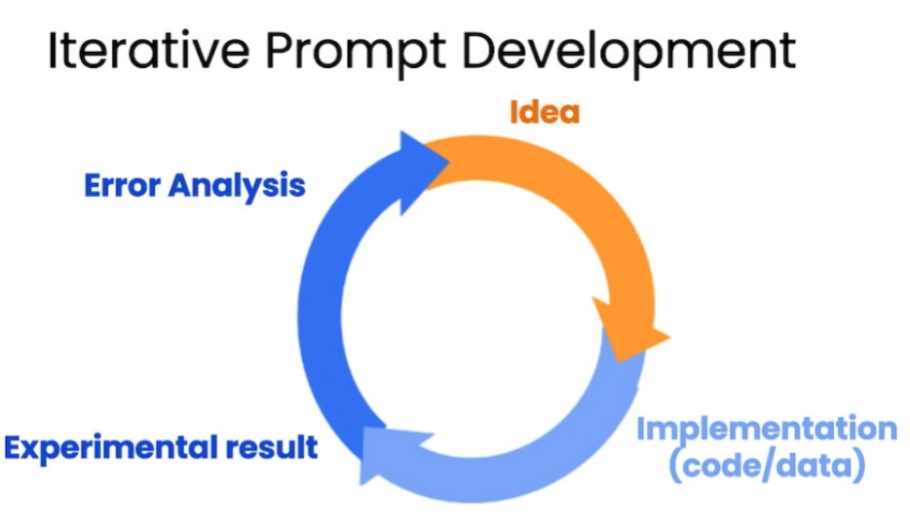
15 Perfect prompts!
Domain + Prompt dev
https://learn.deeplearning.ai/chatgpt-prompt-eng/lesson/1/introduction

Slide 32
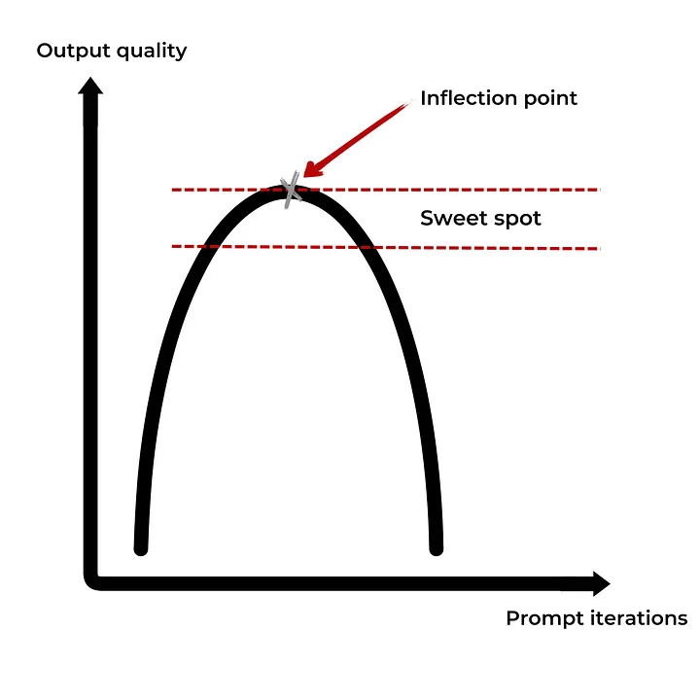
04
Prompt engineering process
State your problem
Examine relevant information
Propose a solution
Adjust the solution:
Test
Basics
Advanced
Concepts
Examine output
Research
Ask GPT
Search the web
Test at *Scale
Launch your solution
Iterate
Credit image - Nabil Alouani
Notes:
*Chat allows to follow up

Slide 33
Demo
Colab “cold email”- https://colab.research.google.com/drive/1Xz8hUTztWJgqLOzCPT4D0UznPBc_DPo_?usp=sharing

Slide 34
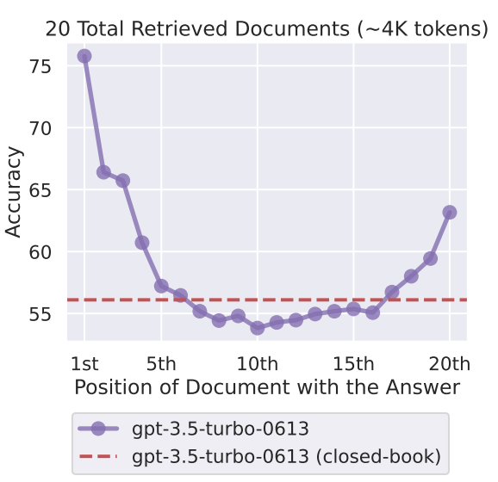
05
Papers
Lost in the middle
Reluctancy to retrieve injections
Take a deep breath
Active prompting
Hallucinations snowball
Many-shot Jailbreaking
Notes:
We will be focusing only on text.
We have a half day workshop on either text or vision generation but today we have only 45 minutes.

Slide 35
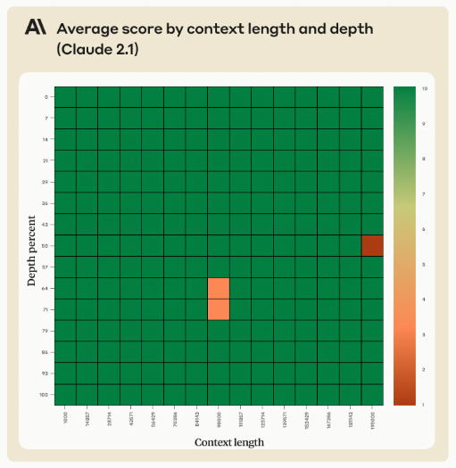
05
Papers
Lost in the middle
Reluctancy to retrieve injections
Take a deep breath
Directional Stimuli
Active prompting
Hallucinations snowball
Gemini vs. GPT vs. MSFT
Notes:
We will be focusing only on text.
We have a half day workshop on either text or vision generation but today we have only 45 minutes.

Slide 36
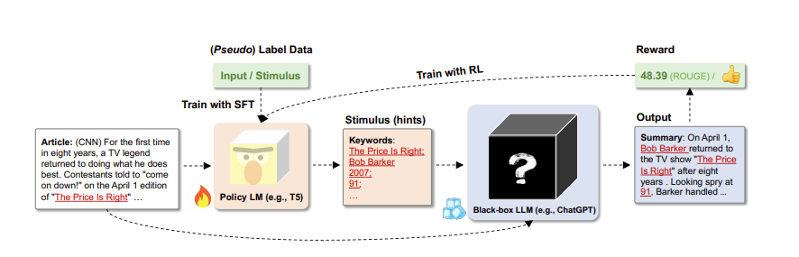
05
Papers
Lost in the middle
Reluctancy to retrieve injections
Take a deep breath
Directional Stimuli
Active prompting
Hallucinations snowball
Gemini vs. GPT vs. MSFT
Notes:
We will be focusing only on text.
We have a half day workshop on either text or vision generation but today we have only 45 minutes.

Slide 37
Demo
Colab “guards”- https://colab.research.google.com/drive/1Xz8hUTztWJgqLOzCPT4D0UznPBc_DPo_?usp=sharing
Notes:
This problem both requires a specific model - code interpreter
It’s also a good example of a prompt challenge
It takes around an hour to get this working

Slide 38
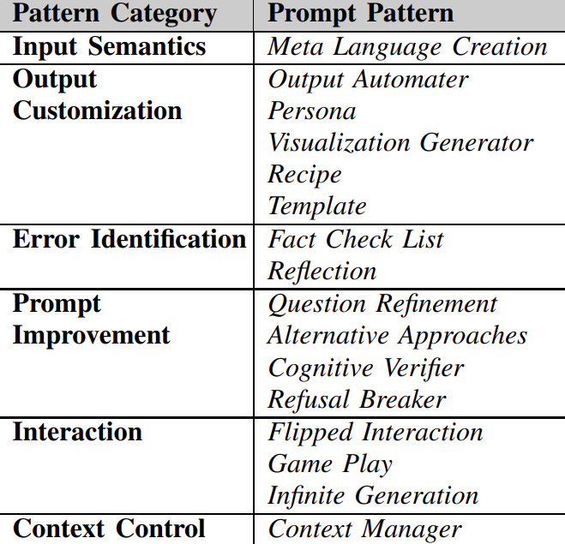
06
Future of prompting
More prompts discovered
Longer prompts akin to computer programs
More control from prompts
More control from models
Only product (10 years +)
https://arxiv.org/pdf/2302.11382.pdf
Notes:
“CoT only yields performance gains when used with models of ∼100B parameters". Smaller models wrote illogical chains of thought, which led to worse accuracy than standard prompting”
“CoT only yields performance gains when used with models of ∼100B parameters". Smaller models wrote illogical chains of thought, which led to worse accuracy than standard prompting”
“There are several different possible ones but step by step works the best”

Slide 39
Future of Prompting
01
02
03
04
Present
Near future
7 years
10 years
Iterative manual process
More methods and algorithms being standardized
The new programming language
Product

Slide 40

How to get started.
Resources:
Learnprompting.org
Master the perfect prompt (YT)
Write expert prompts (Medium)
Notes:
https://learnprompting.org/docs/intermediate/generated_knowledge
https://www.youtube.com/watch?v=jC4v5AS4RIM
https://towardsdatascience.com/how-to-write-expert-prompts-for-chatgpt-gpt-4-and-other-language-models-23133dc85550
https://towardsdatascience.com/how-to-write-expert-prompts-for-chatgpt-gpt-4-and-other-language-models-23133dc85550#0532

Slide 41
Hands On Workshop
Half day revolving around several practical examples.
Agents
Active prompts
Memory
Prompt IDE
Settings
Templating
Etc.
Outcome
Working on several problems with guidance
Notes:
Did not work. Had to be more specific.
Specific is important. Similar to how you talk to a human.
Starting to look more appealing “as one of the most decorated hockey players.

Slide 42

Next Meetup
4.1.24
“Enterprise Gen AI Case Studies”

Slide 43
Thanks!
Do you have any questions? jonathan@shujin.ai
Please keep this slide for attribution

